Slide 1
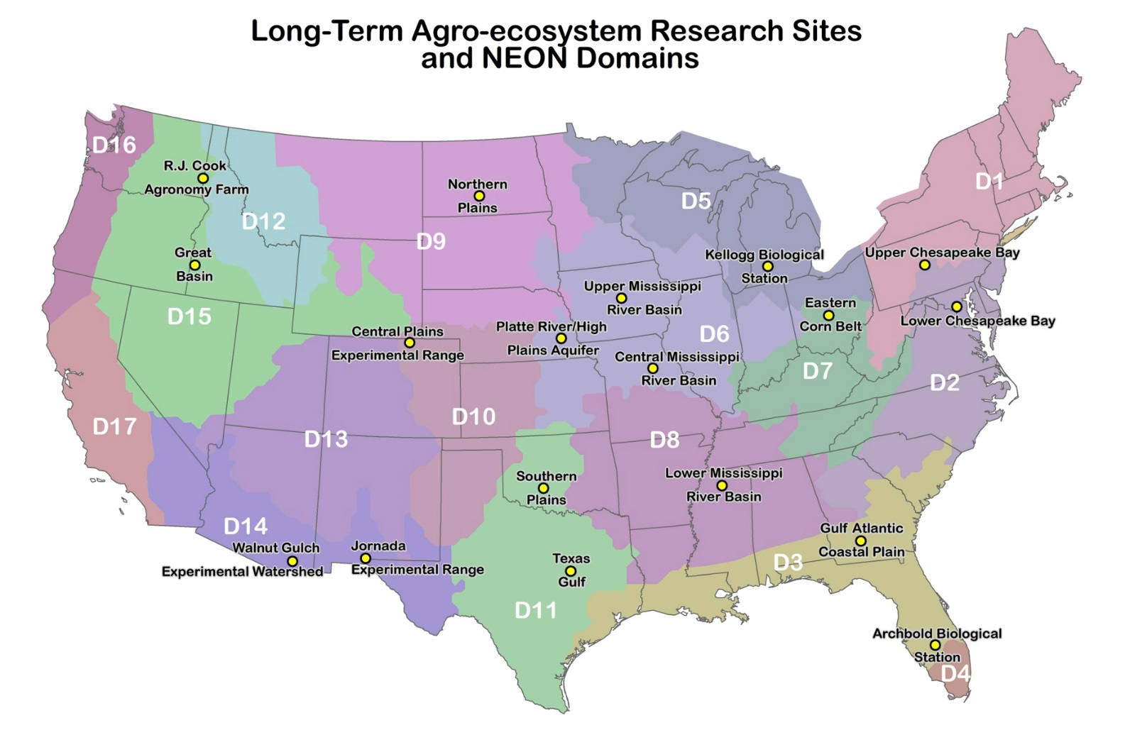
Better Collaboration at a Distance: Tools to Implement LTAR

Slide 2
Better Collaboration at a Distance: Tools to Implement LTAR
Here is a good rule of thumb: If you are trying to solve a problem and there are multi-billion dollar firms whose entire business model depends on solving the same problem, and there are whole courses at your university devoted to how to solve that problem, you might want to figure out what the experts do and see if you can’t learn something from it.
Code and Data for the Social Sciences: A Practitioner’s Guide
Matt Gentzkow and Jesse Shapiro

Slide 3
Better Collaboration at a Distance: Tools to Implement LTAR
Here is a good rule of thumb: If you are trying to solve a problem and there are multi-billion dollar firms whose entire business model depends on solving the same problem, and there are whole courses at your university devoted to how to solve that problem, you might want to figure out what the experts do and see if you can’t learn something from it.
Code and Data for the Social Sciences: A Practitioner’s Guide
Matt Gentzkow and Jesse Shapiro
Current Tools: Conference Calls + Email +????

Slide 4
Better Collaboration at a Distance: Tools to Implement LTAR
As we implement LTAR, we’ll need better tools to document what each committee recommends, makes it easy to consistently apply standard methods, document where each site stands, and collaborate to get the most out of the national datasets we are building.
What do we need?
Data Management – NAL
Code Management - Github
Task Management - Wrike?
Document Editing? – Google Docs
Spatial Data Processing – Google Earth Engine
Document Management – Github wiki?
https://github.com/isdapps/ltar/wiki

Slide 5
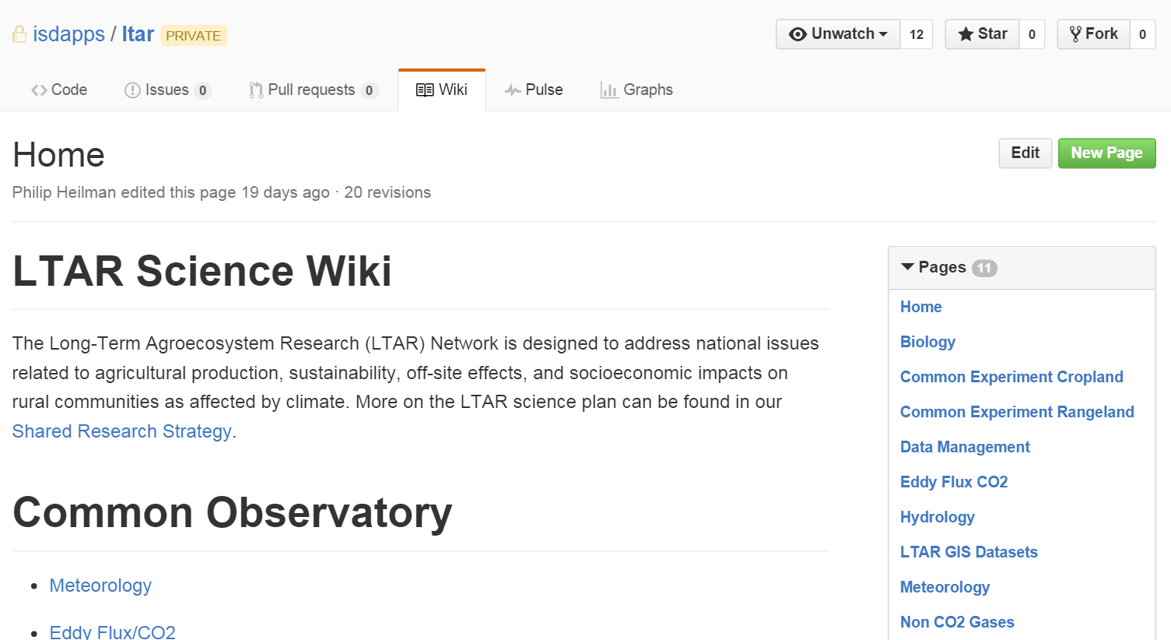
Better Collaboration at a Distance: Tools to Implement LTAR

Slide 6
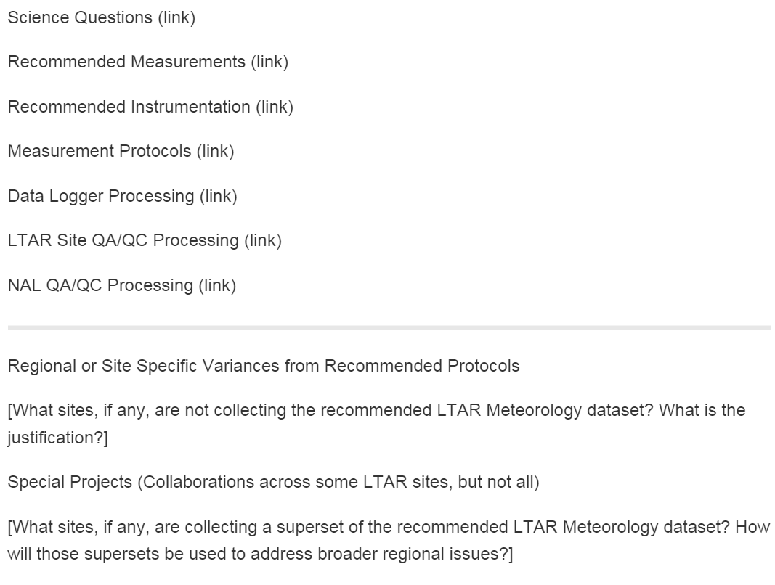
Better Collaboration at a Distance: Tools to Implement LTAR

Slide 7
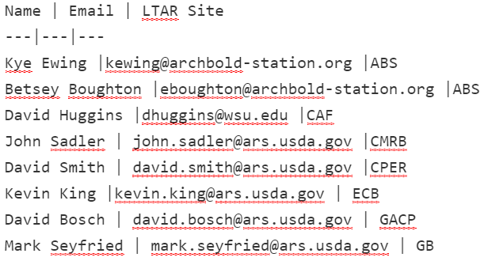
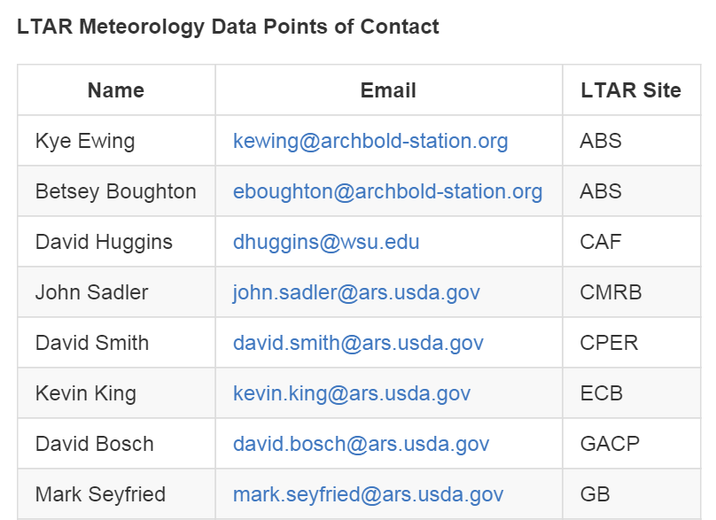
Better Collaboration at a Distance: Tools to Implement LTAR

Slide 8
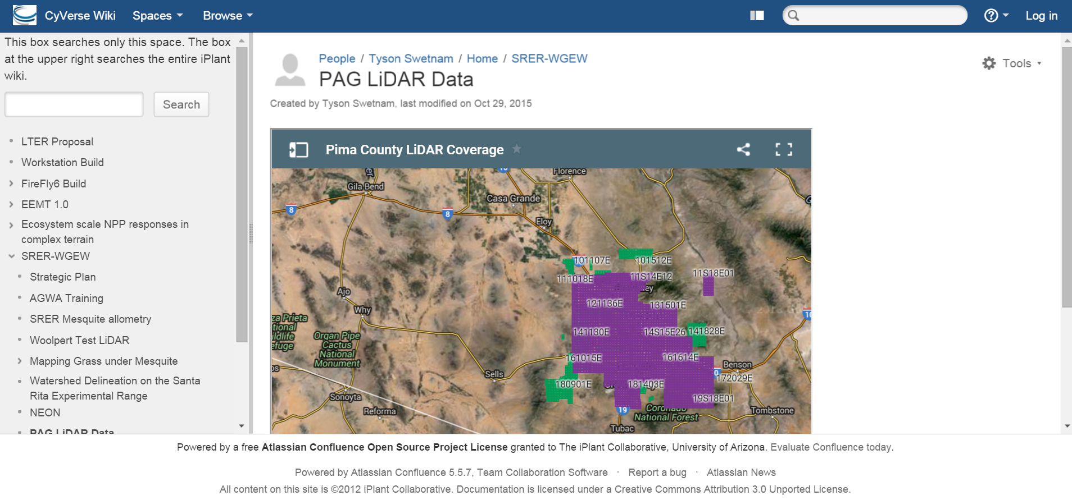
Better Collaboration at a Distance: Tools to Implement LTAR

Slide 9
Better Collaboration at a Distance: Tools to Implement LTAR
Possible Tools/Tradeoffs:
Github – Designed as a source code repository, lots of other “stuff” to detract from documents in wiki, steep learning curve although Markdown is simple, less flexible, free if open. Github is a strong candidate if there will be a lot of collaborative code development.
Atlassian Confluence – Build a wiki using Wiki markup, more complicated than Markdown, but much more flexible. Cost: 100 users would cost $300/mo if hosted on cloud or a $4k one-time payment if we host. Confluence is a stronger candidate if the wiki would primarily be hosting documents.

